Slide 1
Pragmatic Architecture
Simplify, Clarify, Economize
-Rajkumar Chandrasekaran

Slide 2
Who is your host
Sr. Dev Mgr & Innovation lead @ eBay
13+ years of IT experience
Architecture (predominantly JSE/JEE, MicroSoft sometimes)
Passion – Multiple technologies, Operational Excellence, Scalability
Past time – Actionscript, Flex, Javascript (jQuery)
Notes:
Include notes about myself and really brief. A slide may not be required

Slide 3
Why Pragmatic Architecture
Can you Imagine a system that can
process 70+ billion db operations a day
ensure 99.94% availability
contain 15000+ app servers & 1000+ database instances
take on 8 billion url hits a day
maintain 20+ TB worth of log data every day
“This is real and is happening and primarily due to the practical, realistic approaches taken by highly distinguished architects, engineers, management”

Slide 4
Agenda
Takeaways
Elements of Architecture
A peek at what SOA is & is Not
Arch Phases
Real life problem
Q & A

Slide 5
Takeaways
If you are a developer
  Programming for ‘ilities’ (or “abilities”)
  Understand newer/wider/deeper ways of architecting
  Simpler ways to embed Architectural vision into code
If you are an Architect
  Revisit some of the approaches towards building systems
  Sneak preview at highly scalable, highly available systems
If you are in Management
  Greater ROI, Faster returns
  Understand how great architecture can turn the business around
If you are none of the above
    Get all of the above ☺
Notes:
Approaches to architecture:
No Arch, Pure Arch, Pragmatic Arch – Total cost of Ownership (TCO)
Breadth-wise search, Horizontal search. Layering, Tiering, and how deep do we go in
Service Oriented Architectures – What’s SOA, how to build SOA systems, the need for building it, ESB, BPEL etc

Slide 6
Quiz Time
Q: Whose responsibility is Architecture?
Developers
Architects
Management
Security

Slide 7
Approaches to Architecture

Slide 8
Approaches to Architecture
None
No realization
Zero effort in streamlining
High maintenance cost

Slide 9
Approaches to Architecture
Pure
Sometimes very extensive
Misses the big picture, Long-term goals
High maintenance cost

Slide 10
Pragmatic

Slide 11
Pragmatic Architecture
More realistic approach
Fine balance between Architectural Principles and Product Goals
Predominantly Incremental with long-term vision
Enables ‘Fail-fast’
Earns Trust & Respect from stakeholders

Slide 12
Approaches to Architecture

Slide 13
Architecture Evolution

Slide 14
Architecture Basics
– a quick look

Slide 15
Quiz Time
Q: Which of the following makes sense?
Structure is part of Design
Design is part of Architecture
Architecture is part of System
System is part of Architecture

Slide 16
Requirements
Architecture
Structure
Design
Foundation
Framework

Slide 17
Requirements
Application Architecture
Components
Design Patterns
Foundation
Frameworks / Libraries

Slide 18
Requirements
System Architecture
Services / Integration
Tiers / Layers
Foundation
Software / Hardware

Slide 19
Enterprise Architecture

Slide 20
Enterprise Architecture
System Architecture
Application Architecture

Slide 21
Service Oriented Architectures

Slide 22
Quiz Time
Q: Where does Service Orientation paradigm start from?
Web services
Class
Method
Variable

Slide 23
public class SOA
{
public boolean amISOA = true;
public boolean amISOA2()
{
return (!false || !true) && (!(false || true ) || true);
}
}

Slide 24
public class SOA
{
public boolean amISOA = true;
public boolean amISOA2()
{
return (!false || !true) && (!(false || true ) || true);
}
}

Slide 25
Demystifying SOA
Misconceptions :
SOA is just a web service
SOA is only for very large applications
SOA is only used in multi-org integrations
SOA increases scope/estimate drastically
SOA is always a Request-Response sync call
SOA reduces flexibility in all situations

Slide 26
(Back to) Arch Evolution
Goals
Functional & Non functional Requirements/
Long term vision / Architecture Principles / Constraints
Reality

Slide 27
Architecture Phases – Phase I
Understand
Refine
Product Goal
Challenge
“Great listening skills at this stage helps in getting the long term vision right”
Vision
Influence

Slide 28
Architecture Phases – Phase II
Domain View
Product Goal
Collaboration View
Architecture Vision
Deployment View
“Get the big rocks first”
* Domain view – sub domains optional
* Deployment view at a high level

Slide 29
Architecture Phases – Phase III
Product Goal
Further decomposition
Interface Definition
Architecture Vision
Architecture Principles
Domain Composition
Technology Selection
“The devil is in the detail”
Framework Selection
etc, etc and etc

Slide 30
Architecture Principles
Non-Runtime
Flexibility
Maintainability
Runtime
Monitoring
Availability
Scalability
General Guideline
Identify top 3 from
Runtime Abilities
Identify top 3 from
Non-Runtime Abilities

Slide 31
Architecture Phases – Phase IV
Across layers: Interaction requirements (SLA, fault tolerance rate etc)
Within each layer: Optimize, Choose the right technology, Callout non-obvious limitations

Slide 32
Prioritize, Prioritize and Prioritize
Understand which of the abilities are most important to realize your goal

Slide 33
Problem 1 – Huge DB read/writes
Lightening search
8 Billion url hits/day
appox 1 B active users
Requirements
$1, 736 trade per second
99.94% available
10’s of TB of
add’l data to be stored

Slide 34
Solution – Huge DB read/writes
Phase I
Understand multiple domains that need access and Prioritize the need
Abstract out Data access elements in to a separate layer (if that is not the case already)
Phase II
Understand the current infrastructure, data center location, network limitations
Callout inter-domain SLAs and expectations

Slide 35
Solution – Huge DB read/writes
Phase III
Identify data sources that need to be highly available/readable
Ensure Domain App servers reside alongside ‘most-needed’ data sources
Partition DB significantly
Phase IV
Optimize each data source for read/write
Single Write & Multiple reads
Data dependant routing for data spread across physical hosts

Slide 36
Solution – Huge DB read/writes
Domain-wise data split

Slide 37
Solution – Huge DB read/writes
Data dependant Routing & Data push to down stream (synch/asynch) systems

Slide 38
Solution – Huge DB read/writes
DR & Failovers

Slide 39
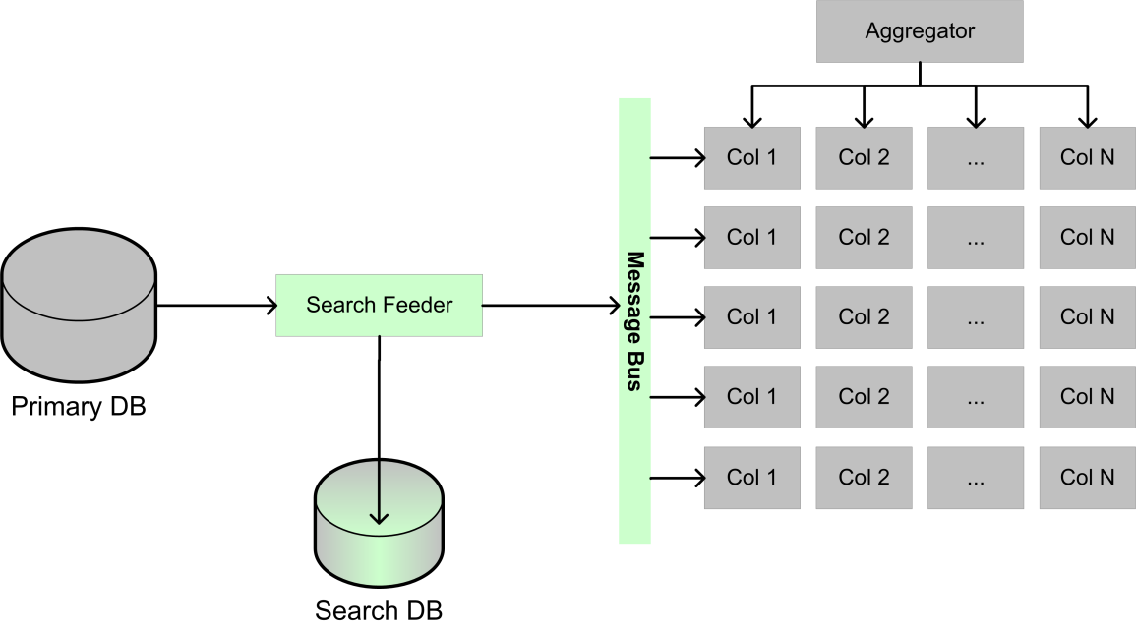
Solution – Huge DB read/writes
‘Divide & conquer’ Indexing & Search

Slide 40
Solution – Huge DB read/writes
Surprises!
NO Foreign Keys
NO Joins
Multiple Physical tables are mapped to one Logical table
Multiple Logical tables mapped to one physical table

Slide 41
Quiz Time
Q: Why would someone translate multiple logical hosts to single physical host
Extensibility / Flexibility
Just for fun
Scalability
They got nothing better to do

Slide 42
Questions
Rajkumar.Chandrasekaran@ebay.com
rajbits@gmail.com
Twitter / Facebook / Orkut / Skype : rajbits

